Slide 1


Accessibility testing for the entire team
Vegard Haugstvedt

Slide 2
Spreading knowledge to 80+ teams at NAV
A mix of internal employees and consultants
Many teams lack dedicated frontend developers
Our work has to be accessible to all

Slide 3
Motivation
Involve the entire team in testing
Spread knowledge about accessibility
Go for the low-hanging fruit first
Cost effective and efficient testing

Slide 4
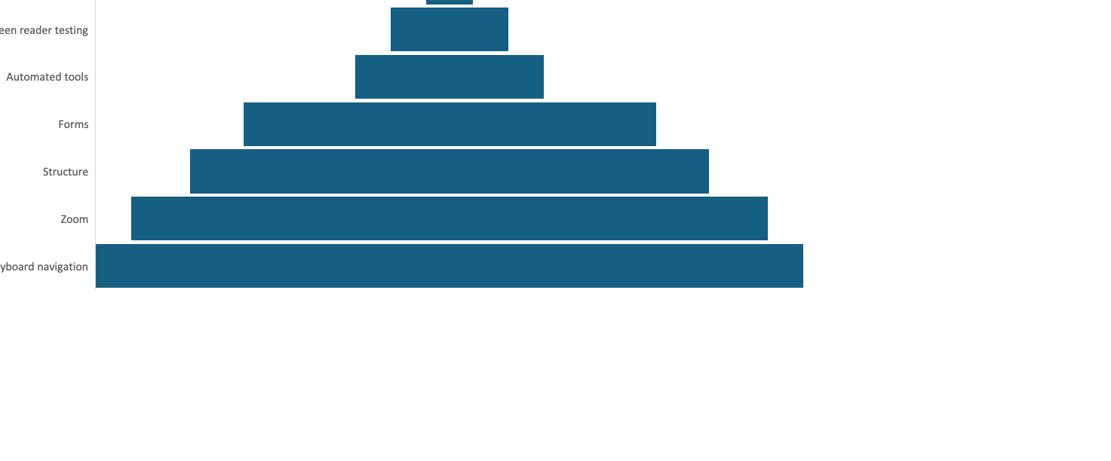
The accessibility testing pyramid

Slide 5
Keyboard navigation
All functionality must be accessible using only a keyboard

Slide 6
What to test with a keyboard
Focus order
Focus indicator
Should be able to perform all the same actions as with a mouse
No keyboard traps
Skip-links (if necessary)

Slide 7
Keyboard testing – what do you need?
Keyboard
Optional: NerdeFocus (browser extension)
Bonus:
Check that all clickable areas are at least 24 * 24 px
(preferably 44 * 44px)
https://adrianroselli.com/2022/05/24x24-pixel-cursor-bookmarklet.html

Slide 8
Task: Keyboard-only navigation
Test your own website using keyboard-only
Try out 1-2 main user flows: Log in, find some information, checkout, etc.
Make sure every component that is possible to interact with can be used with a keyboard.
Alternative site:
arngren.net

Slide 9
Zoom and responsive design
Magnification and user customization

Slide 10
What to test for with zoom and responsive design
Zoom in 400%
320px page width
Portrait and landcape mode
Change font size in browser
Customizable spacing bookmarklet: https://codepen.io/2kool2/pen/LYzVeLO

Slide 11
Task: Responsive design
Pick 3-4 page types on your website and test
Zooming in to 400%
Test increasing font size through the browser
Test landscape and portrait mode (preferably on mobile)
Test
Alternative sites:
Dagbladet.no
JavaZone.no

Slide 12
Structure
Headings and landmarks

Slide 13
What to test for with headings
Sound heading hierarchy
Headings are coded as headings
Headings describe their section
Unique page title
Tool:
HeadingsMap

Slide 14
What to test for with landmarks
Page is divided into landmarks:
Header
Nav
Main
Footer
Aside
Form
All content is contained in a landmark
Tool:
Accessibility Insights

Slide 15
Task: Structure and landmarks
Download the browser extensions HeadingsMap and Accessibility Insights
Find a page with rich content, and check with HeadingsMap if you can understand the structure of the page just from the headings.
Check that no heading levels are skipped
Use the «AdHoc tools» feature in Accessibility Insights to highlight landmarks on the page, and check that:
Navigation elements are wrapped in a navigation landmark
The top menu is wrapped in a banner landmark
The footer is wrapped in a contentinfo landmark
Supplementary content is wrapped in an aside landmark
The rest of the content is contained in the main landmark
Alternative website:
https://www.nav.no/arbeidsledig-permittert
https://www.nrk.no/
https://www.bbc.com/

Slide 16
Forms
Instructions, error management and status updates

Slide 17
What to test for in forms
All fields have a unique, meaningful label
Extra instructions appear before the input field
Clicking the label puts focus in the input field
Autocomplete

Slide 18
What to test for with errors
Errors are easily identifiable
Errors should be connected to the input field
Upon errors at submit-time, focus is moved either to the first error or an error summary
The error message should explain WHAT is wrong and HOW to fix it
The system should accept multiple formats and smaller errors

Slide 19
What to test for with status messages
User should receive feedback upon submit (error, success, etc)
Status messages must be announced by assistive technology
Do not show too many status updates

Slide 20
Task: Forms and status updates
Use either your own solution or the checkout process for an online store.
If testing a checkout process in a web shop, does the site show an update when you add products to the cart?
Test that all input fields have a label, and that clicking on it will move focus into the input field.
Test what happens when you fill out fields incorrectly.
Does an error message appear? Does it explain what is wrong and how to correct it?
Alternative website:
Power.no

Slide 21
Automated tools
Browser extensions, bookmarklets and full-page scanners

Slide 22
Which browser extensions should you use?
Lighthouse
Axe
Accessibility Insights
Optional
WAVE
SiteImprove

Slide 23
Task: Automated tools
Scan the following sites with Lighthouse, Axe or Accessibility Insights:
javazone.no (mobile view)
java.no
bbc.com
vg.no
Your own website
Which errors do you find?
Are there any false positives?

Slide 24
Screen reader testing

Slide 25
Screen reader testing as a non-disabled user
You will never use a screen reader like a blind person
Good for unit testing and end-to-end user flow testing
Spend some time learning the most common commands

Slide 26
Task: Screen reader testing
On MacOS:
In VoiceOver Utility:
Under «Speech», check «Mute speech», unless you brought a headset.
Under Visuals, check that «Show caption panel» is checked.
Launch VoiceOver (built-in)
On Windows:
Download and install NVDA (free)
From the NVDA taskbar menu, select Tools > Speech viewer
Mute your laptop sound, unless you brought a headset
Try out your own website, or one of the ones you have tested earlier.
Try performing 1-2 user flows, and check that all links, buttons, headings etc. are communicated equivalently to visual presentation.

Slide 27
User testing

Slide 28
Testing with real users
You really can not know if your site is usable for people with disabilities without testing with people with disabilities.
Accessible (technically functional) vs. usable (easy to use)
Do not recruit people with disabilities too early!
Diversity is important!
Contact interest groups like «Blindeforbundet», but be aware of selection bias.

Slide 29
What did we not cover?

Slide 30
What we didn’t cover
Time-based media
Alternative text/image descriptions
No flashing content
Mouse: Cancel clicks
Page language

Slide 31
